Slide 1
Team 1: Operational Energy
Project Update
Bill Berklich
Christy Brennan
Steve Mazza
Dan Torres

Slide 2
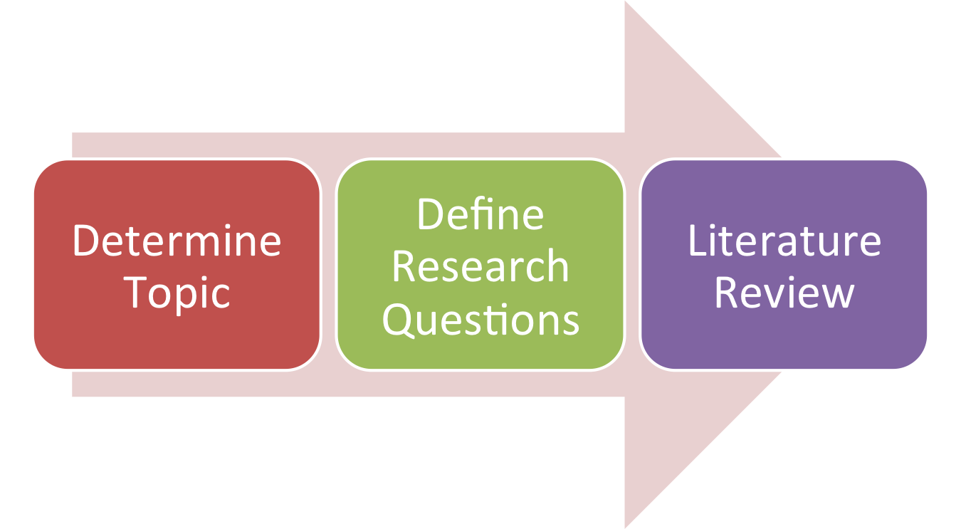
Current Status

Slide 3

Project Risks

Slide 4

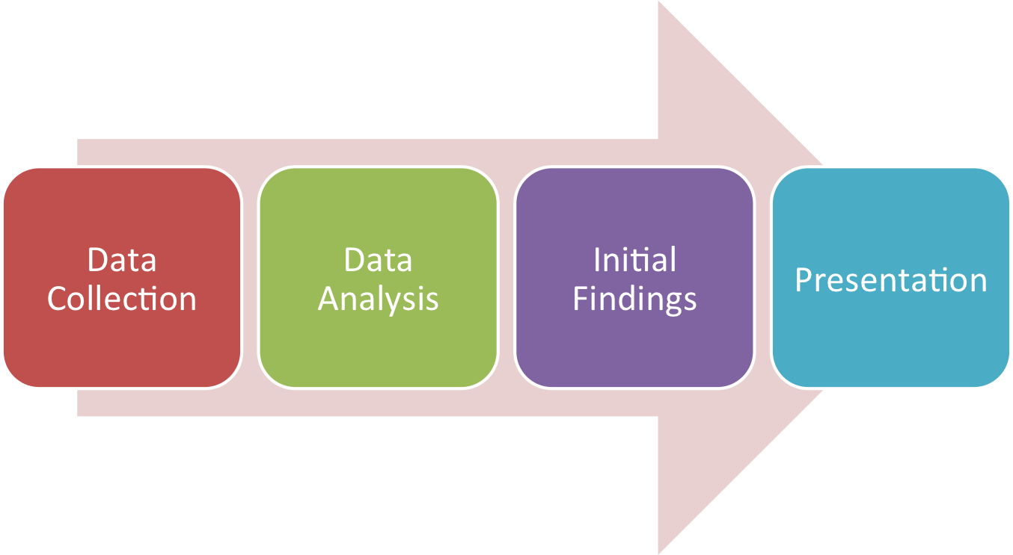
Roadmap

